Slide 1
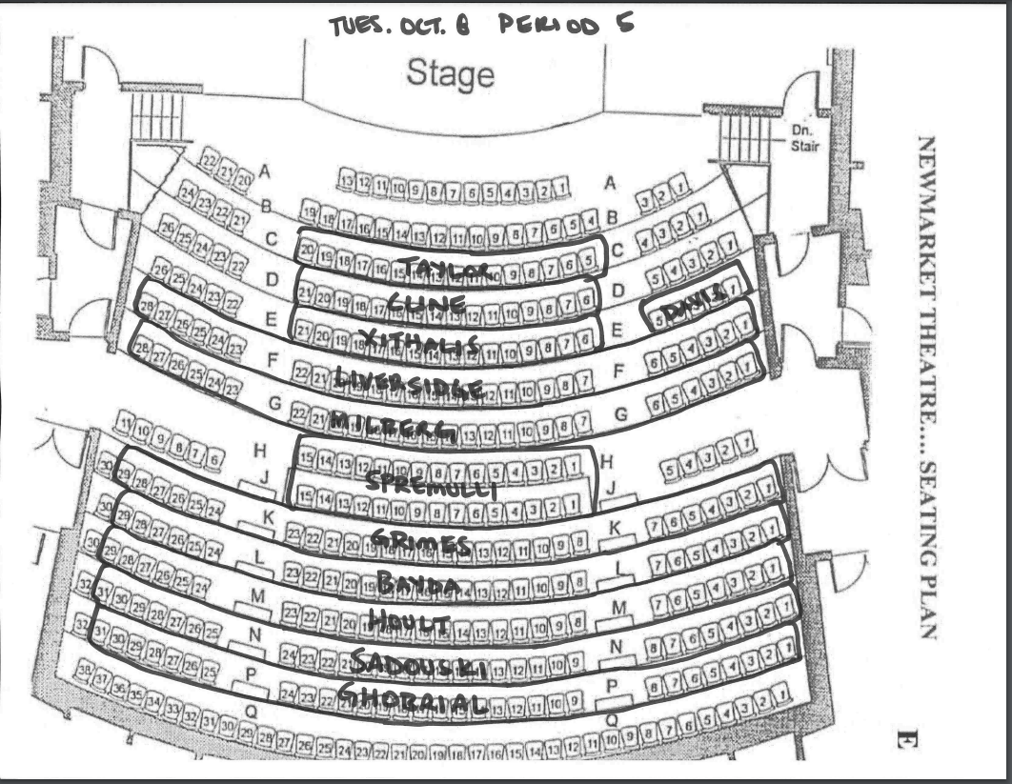

Slide 2

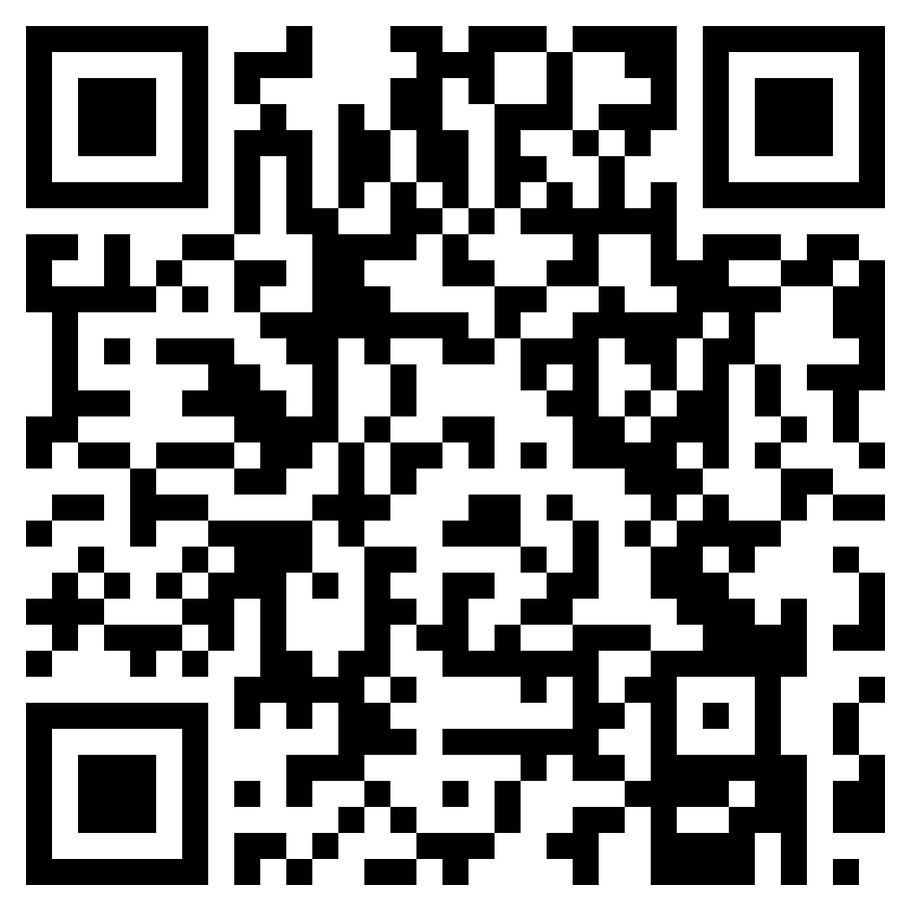
Welcome Graduating Class of 2025!
Newmarket High School
Gr.12 Kick-Off Presentation

Slide 3
Post-Secondary Planning Meetings For NHS Students
Tuesday October 8th | Thursday October 10th | Tuesday October 15th | Dec. 12th to 14th Drop-In for “how to apply” sessions
All presentations can be found on the Google Classroom and the Newmarket High School Website, under the Guidance tab.
Period 5 - Introduction to Grade 12 -Scholarship Information | Period 2 University Pathway Information Session | Period 1 College Pathway Information Session | Monday Dec 9 Period 3 & 5 Tuesday Dec 10 Period 2 & 4 Wednesday, Dec 11 Period 1

Slide 4
Important Deadlines
January 15, 2025
Deadline to apply to University (OUAC)
ouac.on.ca
February 1, 2025
Deadline to apply to College (OCAS) for equal consideration
ontariocolleges.ca
Ontario University & Ontario College Applications are NOW OPEN

Slide 5

Graduation Photos
November 11 to 14
Edge Imaging - Bookmygrad.ca
Sitting Fee
approx. $50

Slide 6
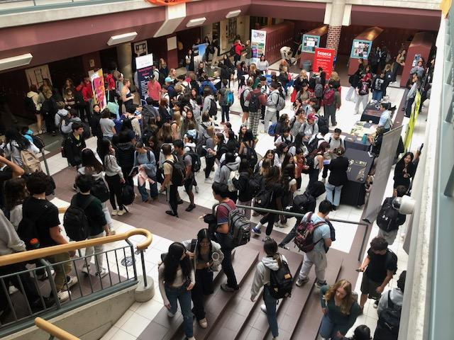

POST SECONDARY
FAIRS
23 universities
24 colleges
apprenticeships
workplace
October 10th @ Sacred Heart CHS from 6-8 pm

Slide 7


Graduation
Tuesday, June 24th, 2025
Prom
Thursday, May 29th, 2025

Slide 8

Graduation Requirements
✔ 18 Compulsory Courses
✔ 12 Elective Courses
✔ Successful completion of Literacy Requirement
✔ 2 Online Learning Credits
✔ 40 hours of Community Involvement

Slide 9
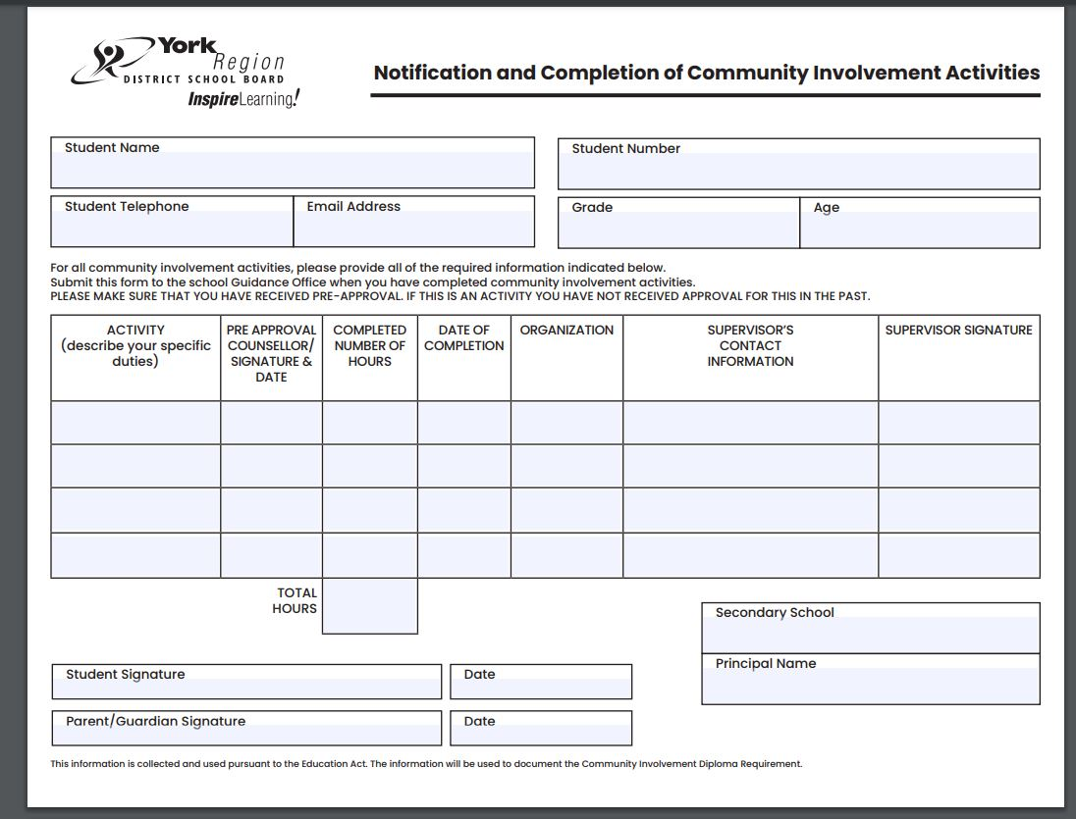
Submit your Community Involvement Forms
390 potential graduates 185 missing hours = 46% NOT done

Slide 10

Secondary Online Learning Graduation Requirement Opt Out

Slide 11
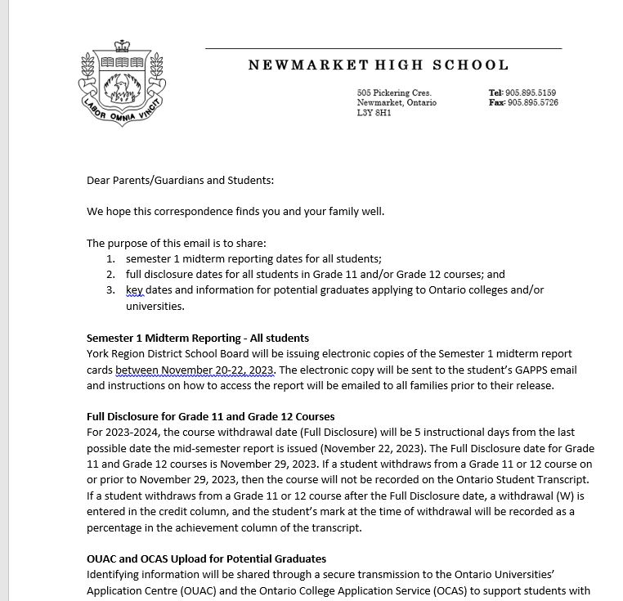
Academic Records
Full Disclosure
November 27 2024 (Transmission: Nov. 19) (Semester 1)
May 6 2025 (Transmission: Apr. 24)
(Semester 2)
Mark will stay on transcript

Slide 12
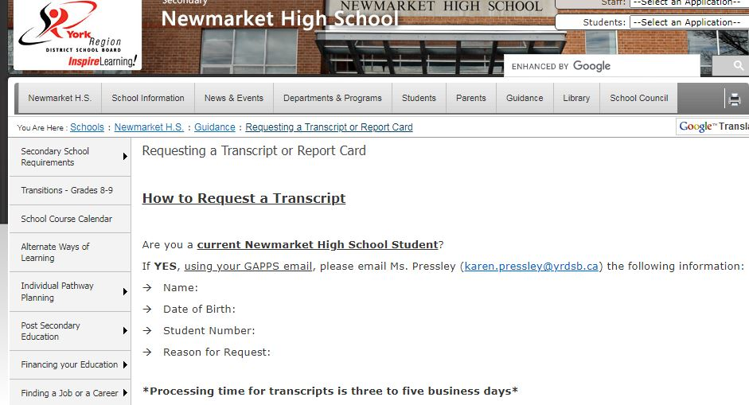
Transcripts
Post-Secondary Transmissions are uploaded automatically on set dates
For example:
Sem.1 midterm marks Nov.19th

Slide 13

Students with Exceptionalities
Educational institutions have a legal obligation to provide reasonable accommodations that promote equity for people who have disabilities. Given that each student’s needs are unique, services and accommodations are established on a individual basis and based on the documentation provided.
Students may also qualify for additional financial assistance for specialized equipment or services while studying at University and College.
To qualify for consideration, access to services, academic accommodations and assistive technology students are responsible for identifying themselves and providing the post-secondary school with relevant/recent documentation
Check out the transition resource guide.
www.transitionresourceguide.ca

Slide 14


MOBYSS
The mobile youth clinic is a safe space to speak to mental or medical health professional. On staff is a nurse practitioner, youth mental health worker and a peer support specialist. 100% free and no Health Card needed!

Slide 15

NHS Guidance Counsellors
Ms. Perin | A – Fe
Ms. Andrade | Fi - Ki
Ms. Calleja | Kl-P
Ms. Yu | Q - Z
Book an appointment via TeachAssist

Slide 16
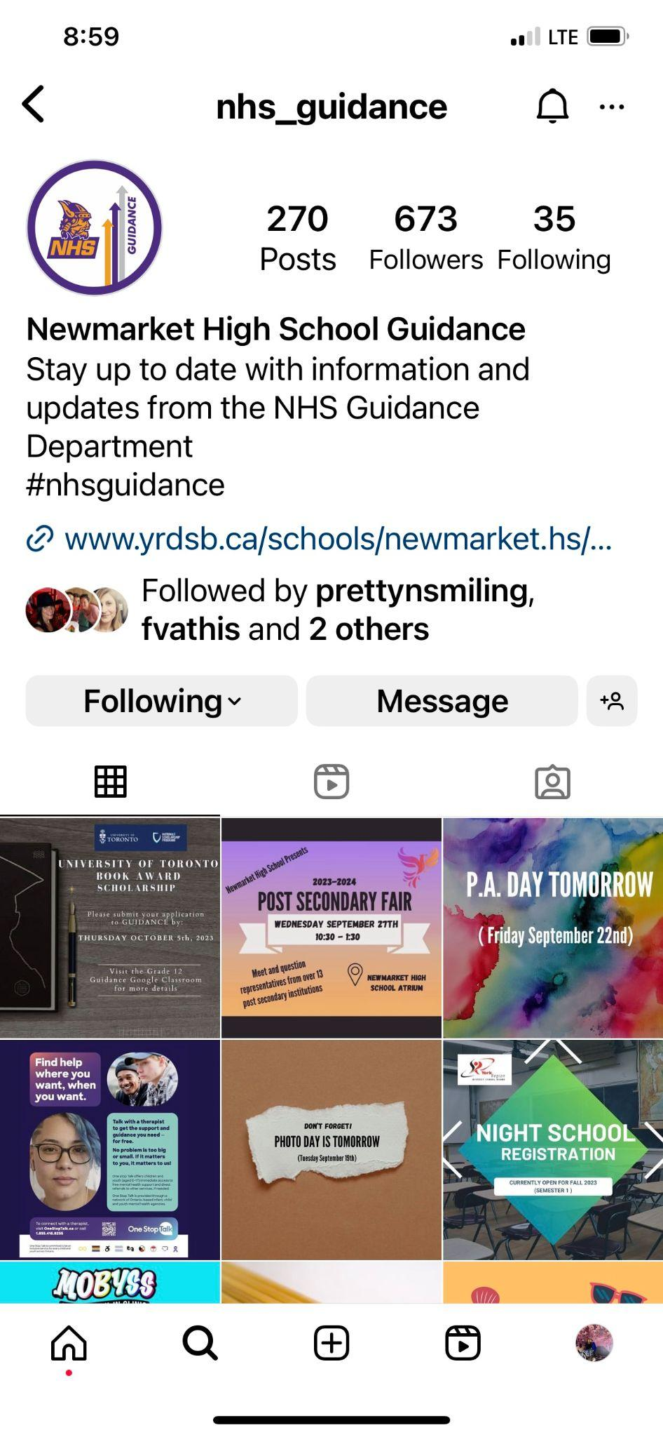


Create and use ONE professional email address for post-secondary correspondence.
NHS Guidance will communicate important information through:
Google Classroom
Announcements
Instagram @nhs_guidance
Communication

Slide 17




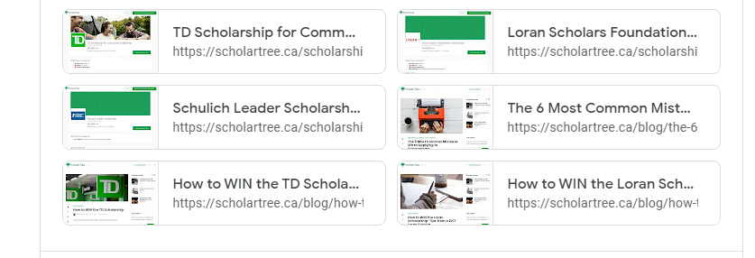

Slide 18
Questions & Misconceptions
OSSD - Diploma | Red Seal with SHSM French Immersion - Certificate 30 credits (doesn't matter how many)
Early Acceptance -NOT REAL | Competitive programs will send out offers Post-March Break Grade 11 marks are visible but will not be used
Grades-Only | Not all programs have supplemental
Out-of-country/Out-of-province | 0.01% of graduating students (please let your guidance counsellor know immediately - we need to process information on COMMON APP for US)

Slide 19


Scholarships, Awards and Bursaries

Slide 20
What is the difference?
Scholarships
Awards
Bursaries
Scholarships are typically merit based and recognize academic excellence, but may also include criteria such as financial need.
Awards combine academic criteria and non-academic criteria such as community service, leadership and financial need.
Bursaries are primarily designed to assist students with financial need.
They are a non-repayable sum of money awarded to help finance post-secondary education including as tuition, books and/or residence.
Notes:
Source: https://sfs.yorku.ca/scholarships-awards-bursaries

Slide 21
What are the different types?
Scholarships
Awards
Bursaries
Entrance Scholarships
based on an admission average
Merit Scholarships
School-Nominated Scholarships
Athletic Scholarships
High School Awards (available April 2025)
Bursaries/Grants
based on financial need

Slide 22

Who offers scholarships?
Companies
Charitable Organizations / Associations
Government
Post Secondary / Schools
Religious Organizations

Slide 23
What are the criteria?
Well-Rounded
Specific Skills
Strong Academics
Community Involvement
Extra Curricular Activities
Leadership Roles
Essay Writing
Multimedia
Math
Science/Technology
Athletics
Public Speaking
Employment
Well-rounded
Specific Skills - Strengths in a following area:
Essay Writing, Multimedia, Math, Science/Technology, Athletics,
Public Speaking or Employment

Slide 24

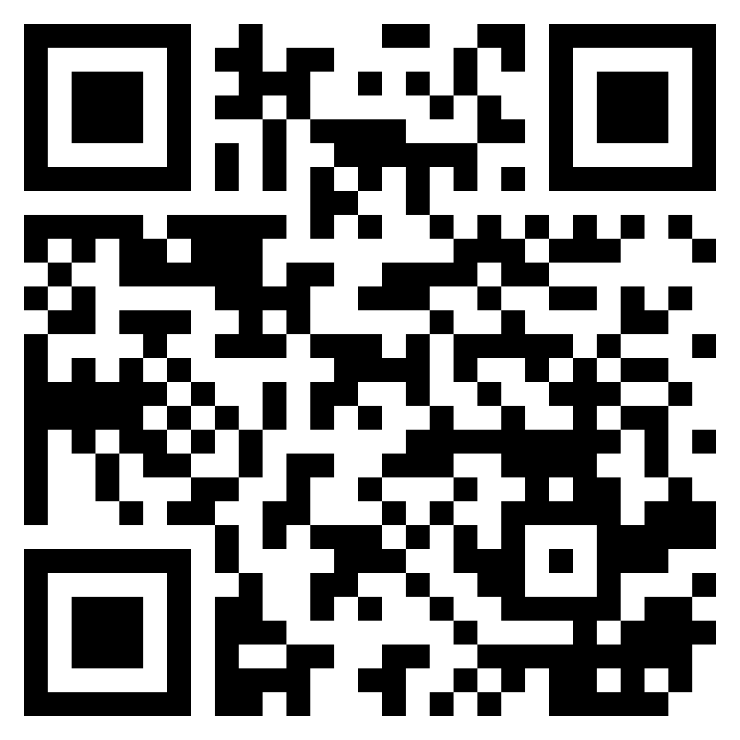
Scholarship Research
www.scholarshipscanada.com

Slide 25


Scholarship Research
www.ontariouniversitiesinfo.ca

Slide 26
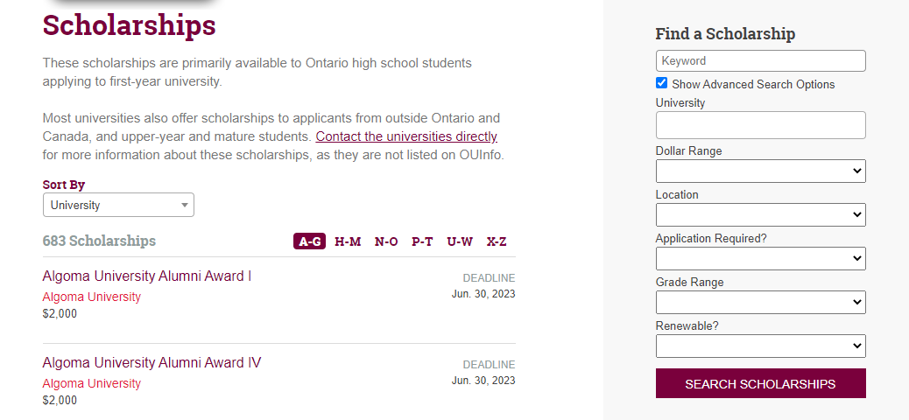
Scholarship Research

Slide 27

Scholarship Research

Slide 28


Scholarship Research
www.ontariocolleges.ca
Click “Paying for College”

Slide 29
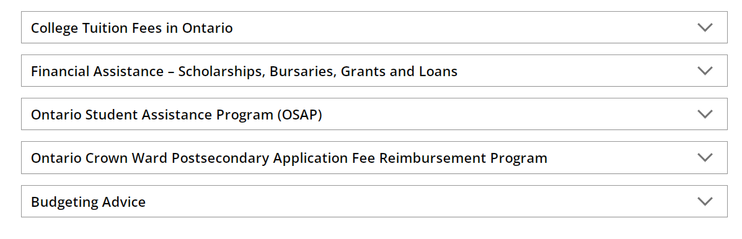
Scholarship Research
Provides you links to various websites for scholarships

Slide 30
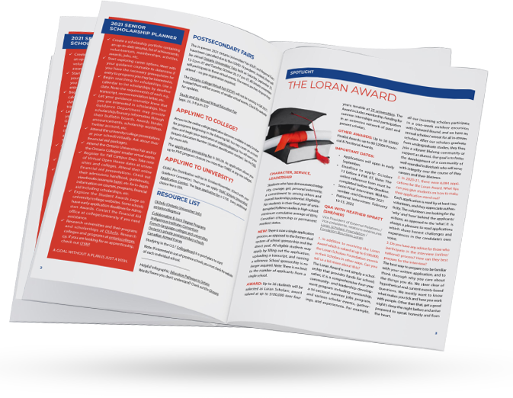
Scholarship Research
The Scholarship Report will be shared on the Google Classroom.

Slide 31
Scholarship Preparation
📋 Plan ahead and know the requirements, eligibility criteria and deadline for applications.
📋 Consider your digital footprint
📋 Prepare your resume and order transcripts.
📋 Request a letter of recommendation from teachers and/or community members at least 3 weeks before submission.
📋 Make a Guidance appointment to review your application. Bring your resume, rough drafts, and letters of recommendation. Leave plenty of time before the deadline.

Slide 32

Scholarship Application Process
✔ Complete your applications
✔ Seek feedback from family and teachers
✔ Meet with your counsellor to review your application

Slide 33
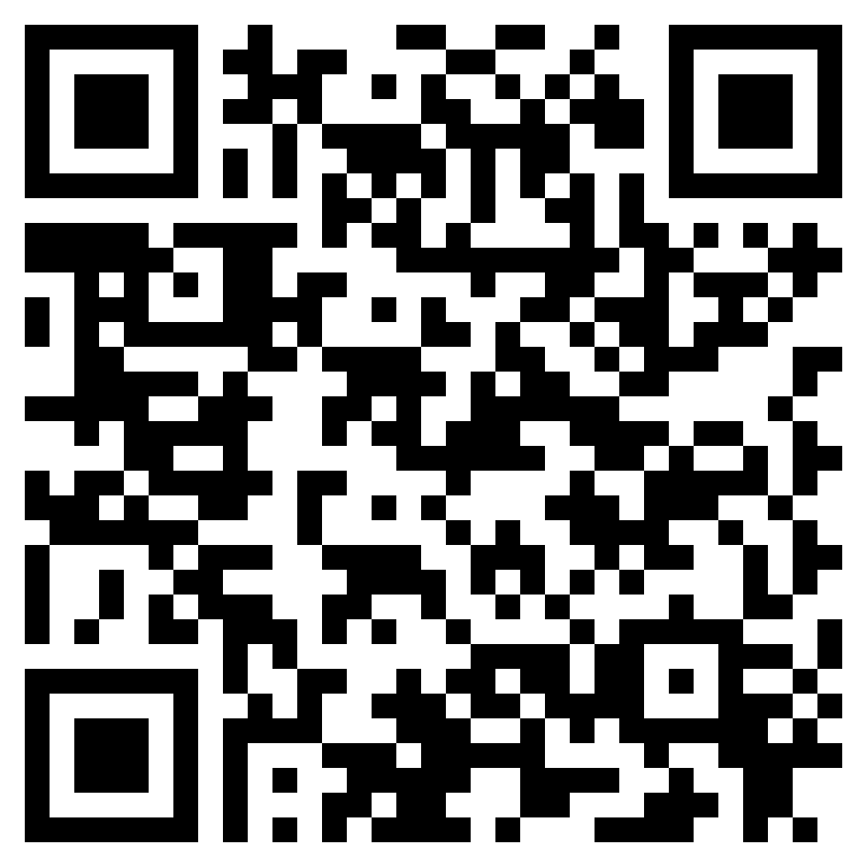


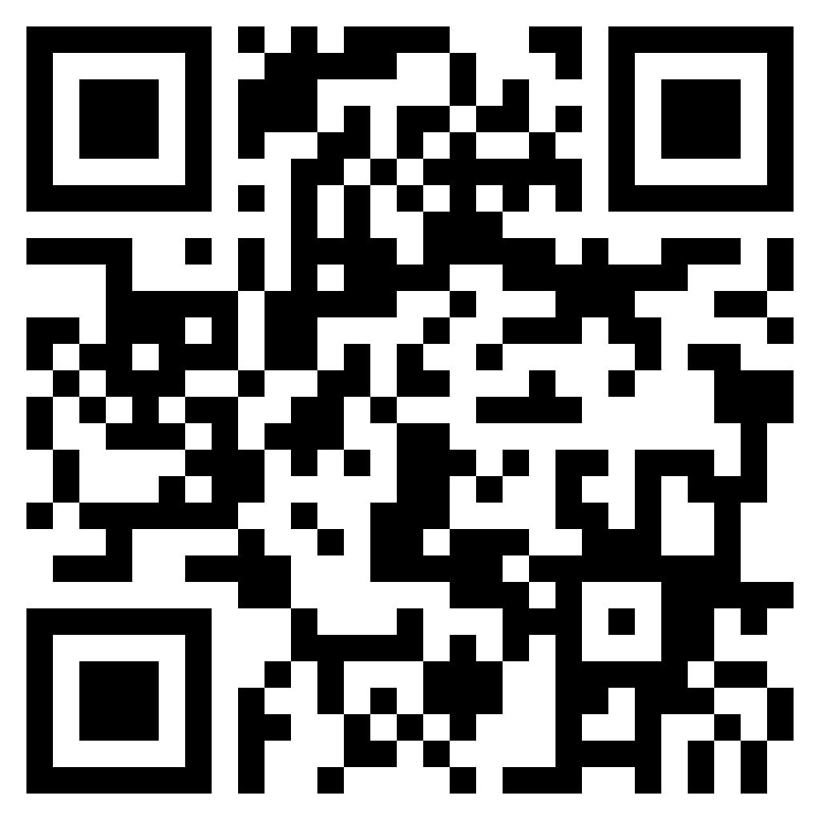

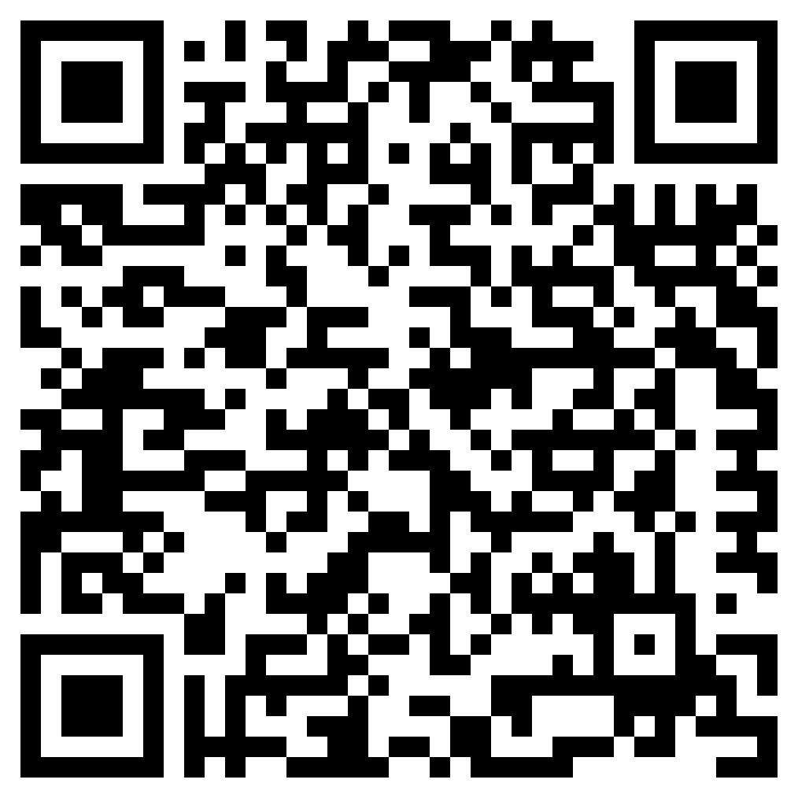
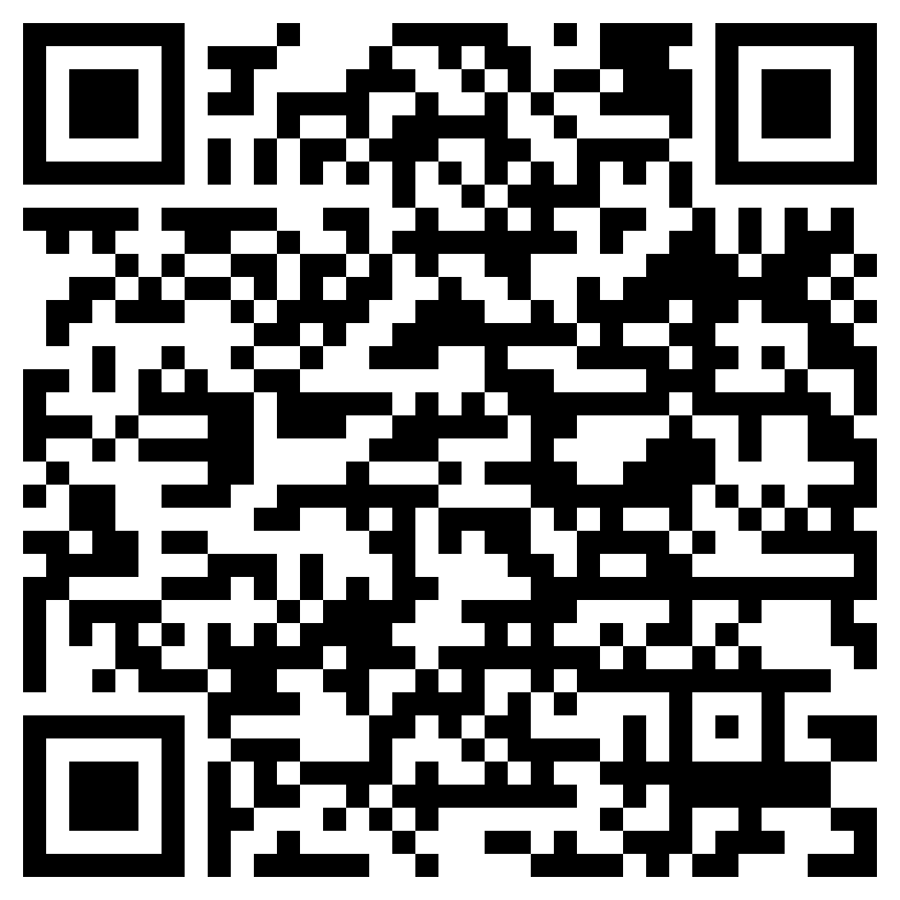

School-Nominated Scholarships
📌 University of Toronto Book Award
📌 Queen’s University Chancellor’s Scholarship
📌 Western University National Scholarship Program
📌Schulich Leader Scholarship

Slide 34


School-Nominated Scholarships
Scholarship descriptions and application forms will be shared on the Google Classroom.
NHS nominated candidate will be selected by the NHS Scholarship Committee.

Slide 35


